Slide 1
Repetition
Notes:
Purpose
To introduce the use of loops in j2code.
Learning objective
By the end of this tutorial children should be able to:
Understand that loops can be used to repeat sections of a program.
Create programs with simple loops.
Resources
Template: j2e.com/code/template/Y3template1
Example: j2e.com/code/example/Y3example1
Video: j2e.com/help/videoY3video1

Slide 2
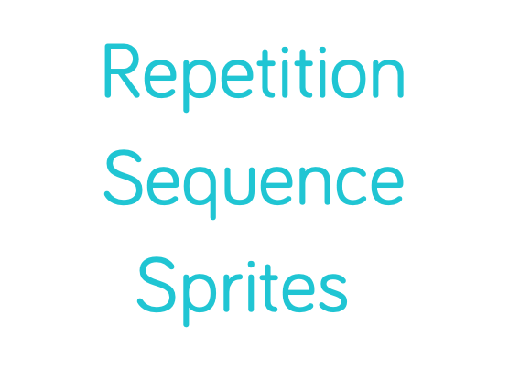
Notes:
Introduce students to key vocabulary for this lesson:
Sequence: “When we sequence things, we arrange them in a particular order. Sequence-based algorithms are made from a precise set of instructions.”
Repetition: “This is the recurrence of actions or events. For example, we eat our lunch each lunchtime and might watch a favourite soap every evening. Repetition in programming means to repeat the execution of certain instructions.”
Sprites: These are the images that perform actions in a visual program. Examples are the penguin, rocket etc. Note, however, that the backgrounds are also known as sprites.

Slide 3
Why is repetition important? Repetition allows algorithms to be simplified by stating that certain steps will repeat until told otherwise. This makes designing algorithms quicker and simpler because they don't need to include lots of unnecessary steps.
Notes:
Remind the students about the importance of repetition in coding.

Slide 4
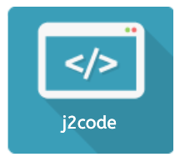
Notes:
Purpose:
To introduce the use of loops in j2e code visual.
Learning objective
By the end of this tutorial children should be able to:
Understand that loops can be used to repeat sections of a program.
Create programs with simple loops.

Slide 5
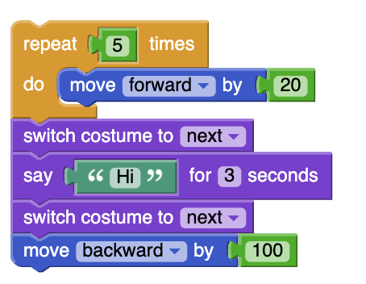
Notes:
Ask your students to trace this code (read though it). What can they see? Can they make a prediction as to what this code will do?
Are there any coding blocks they recognise from previous lessons/ are they any new blocks?

Slide 6
Notes:
Now show them the video j2e.com/help/videoY3video1 as well the code.
Q. How can we make a sprite "speak“? Watch the example and discuss.
Q. How do the spites move?
Q. Why have we used the loop block? (Try the code without the loop block, why doesn’t this work?)

Slide 7
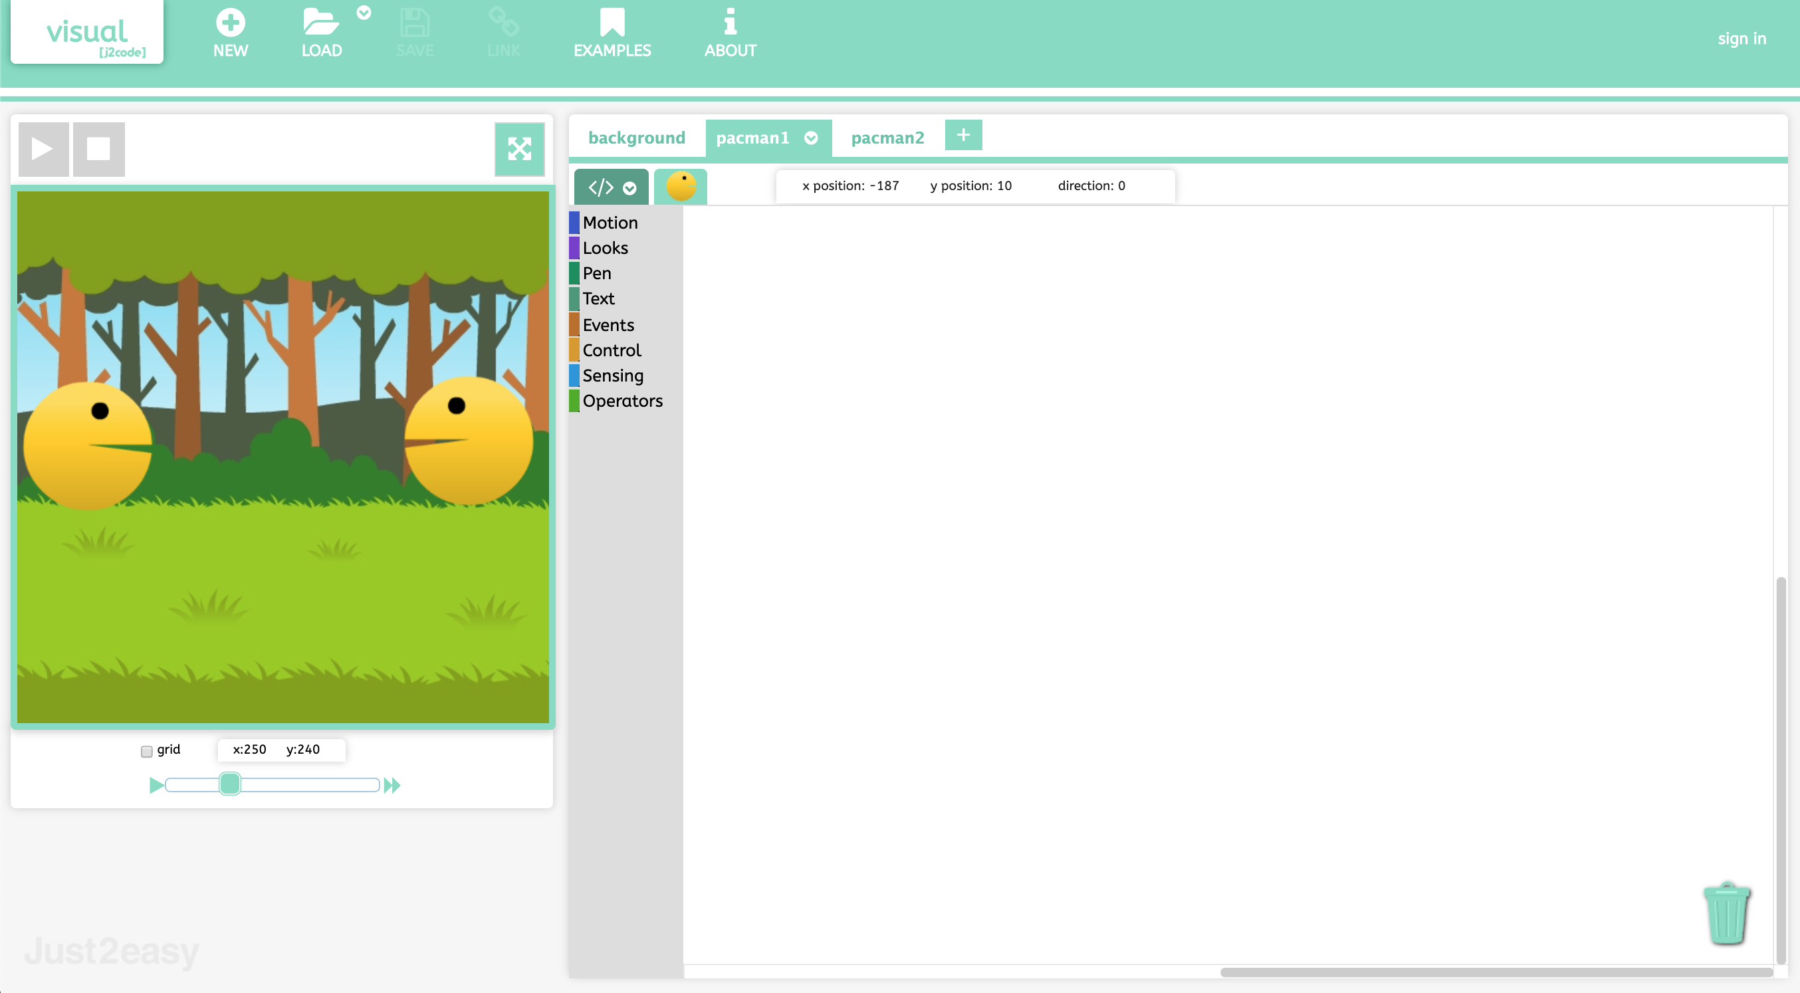
Notes:
Ask students to load the template.
Template: j2e.com/code/template/Y3template1
Task 1- children experiment with making one of the sprites move and animate using the "repeat", "move forward" and "switch costume to next" blocks.
Stop the class to discuss any problems/observations.
Task 2- get the second sprite to move and animate so that the two sprites meet. Then add in a "say" block, so the sprites may greet each other.

Slide 8
Notes:
Explore and challenge
Try some different actions when the sprites touch. Experiment with new backgrounds and animations.
Try to make the sprite say something as its mouth opens, as shown in the example.

Slide 9
Notes:
Explore and challenge
Ask students to make a simple animation relating to their topic, for example ‘The Romans”.
https://www.j2e.com/london-grid-for-learning/bdardis/Roman+Animation/
Allow another session for the students to share and explore each others.

